Slide 1
A Dynamic Programming Algorithm for RNA Structure
Prediction Including Pseudoknots
Elena Rivas and Sean R. Eddy
J. Mol. Biol. (1999) 285, 2053-2068
Speaker: Chia-Hung Chang
Date: Sept. 19, 2007

Slide 2
Abstract
We describe a dynamic programming algorithm for predicting optimal RNA secondary structure, including pseudoknots. The algorithm has a worst case complexity of O(N⁶) in time and O(N⁴) in storage. The description of the algorithm is complex, which led us to adopt a useful graphical representation (Feynman diagrams) borrowed from quantum field theory. We present an implementation of the algorithm that generates the optimal minimum energy structure for a single RNA sequence, using standard RNA folding thermodynamic parameters augmented by a few parameters describing the thermodynamic stability of pseudoknots.

Slide 3
We demonstrate the properties of the algorithm by using it to predict structures for several small pseudoknotted and non-pseudoknotted RNAs. Although the time and memory demands of the algorithm are steep, we believe this is the first algorithm to be able to fold optimal (minimum energy) pseudoknotted RNAs with the accepted RNA thermodynamic model.

Slide 4
Input & output
Input:
  A single RNA sequence
Output:
  An optimal RNA secondary structure with consideration of pseudoknots

Slide 5
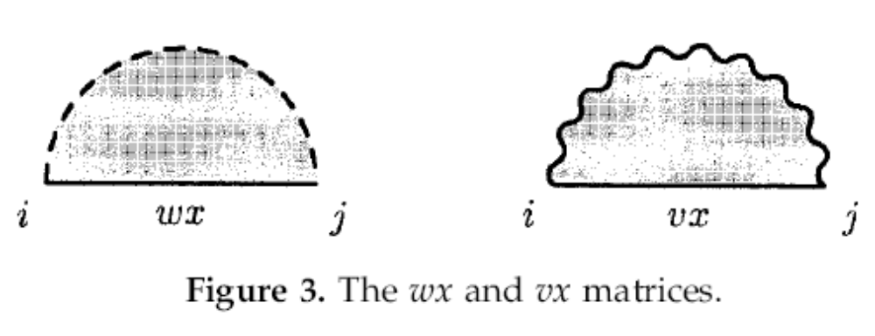
Preliminaries

Slide 6
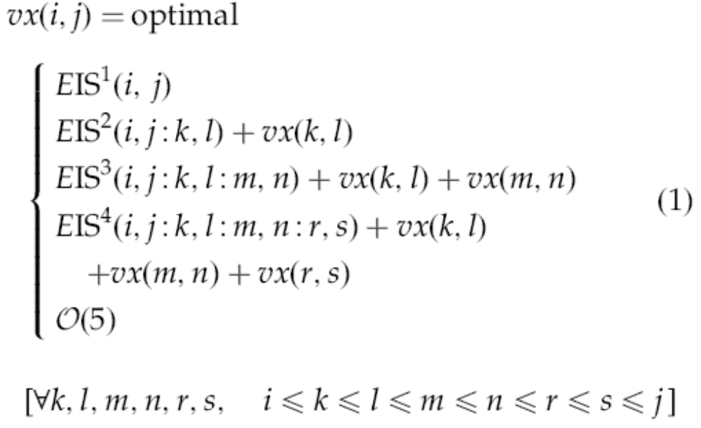
The recursion equation 1

Slide 7
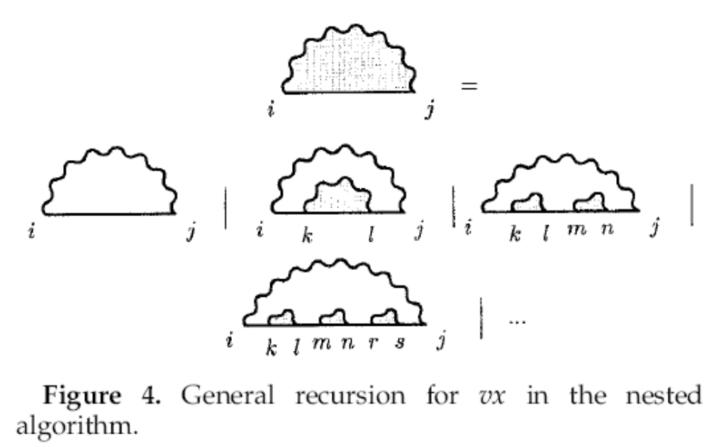
Graphical representation

Slide 8
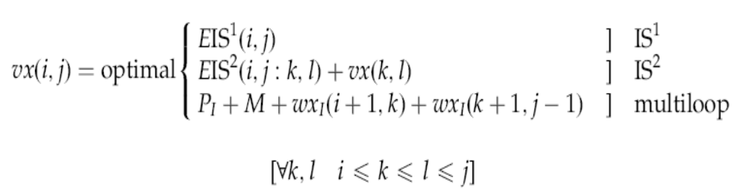
Overview
Fix the equation 1

Slide 9
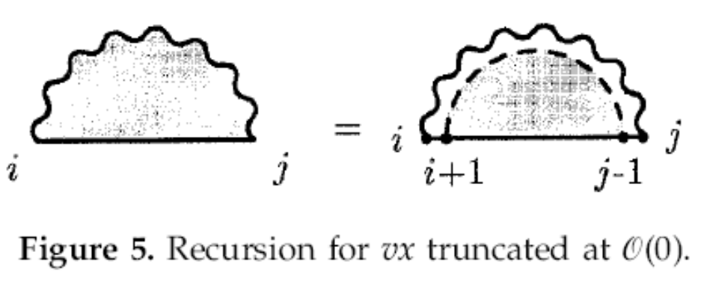
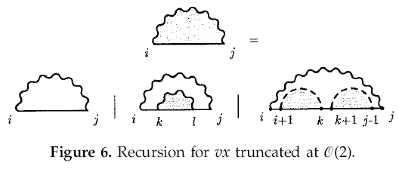
Overview

Slide 10
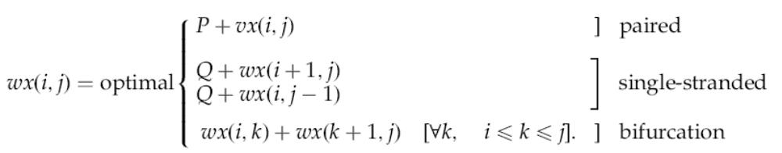
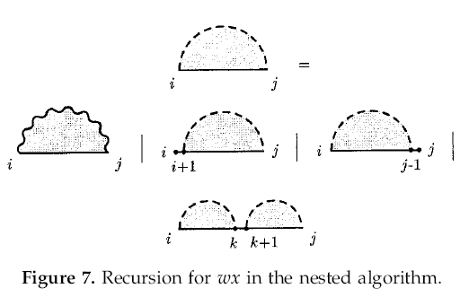
Overview

Slide 11
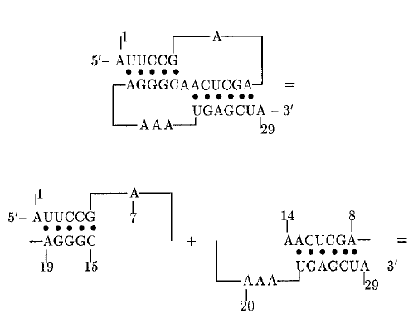
The pseudoknot algorithm

Slide 12
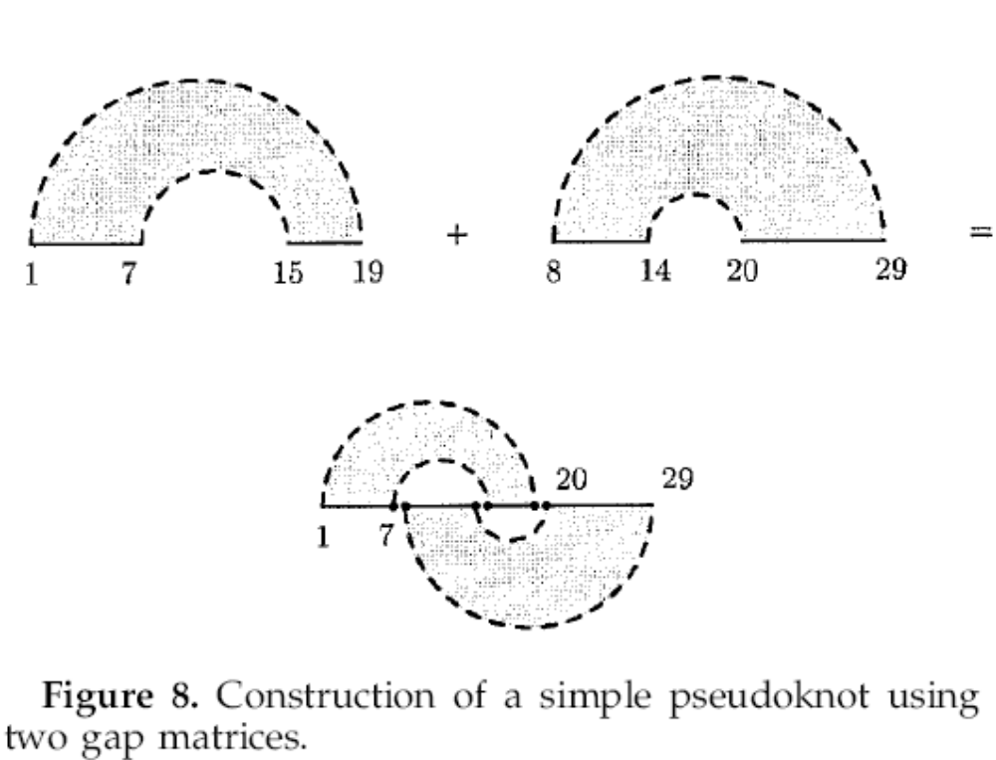
The pseudoknot algorithm

Slide 13
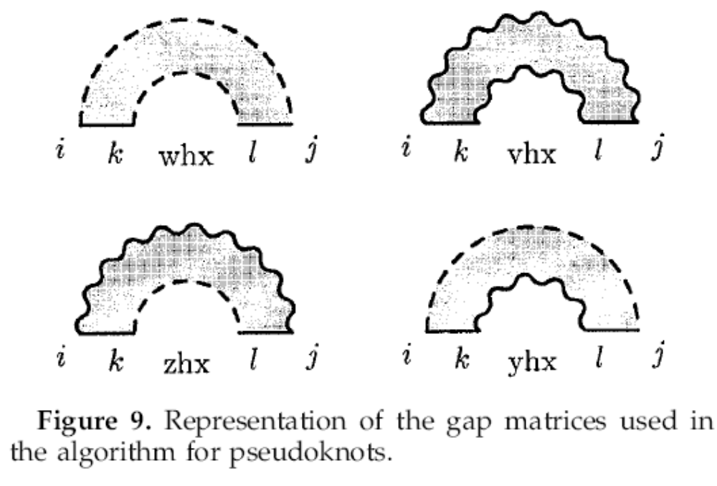
The pseudoknot algorithm

Slide 14
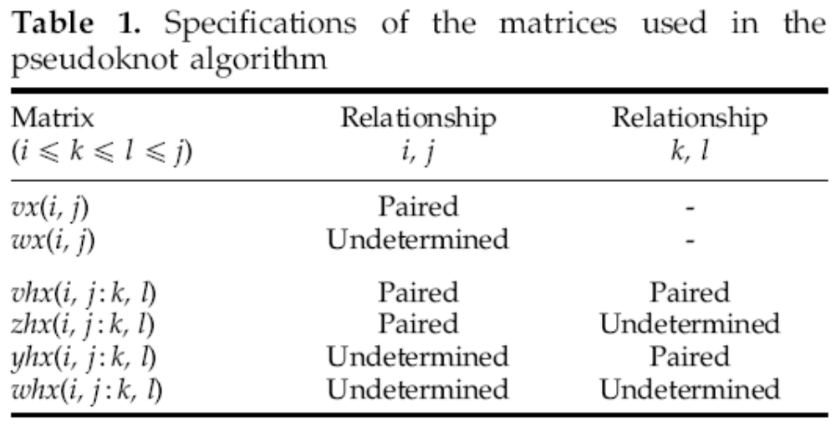
The pseudoknot algorithm

Slide 15
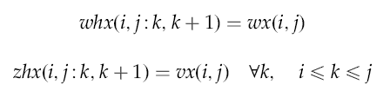
The pseudoknot algorithm

Slide 16
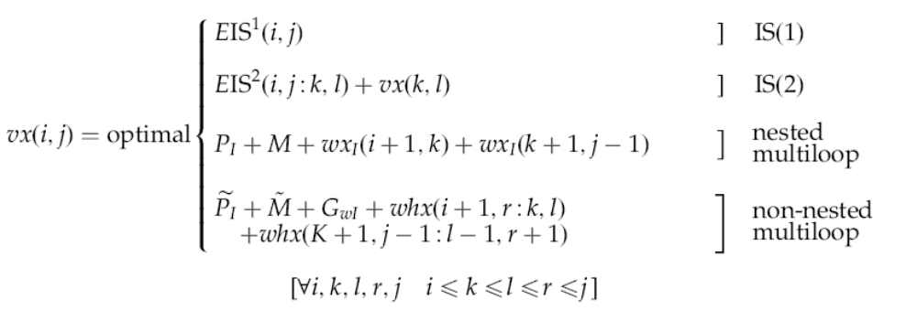
The pseudoknot algorithm

Slide 17
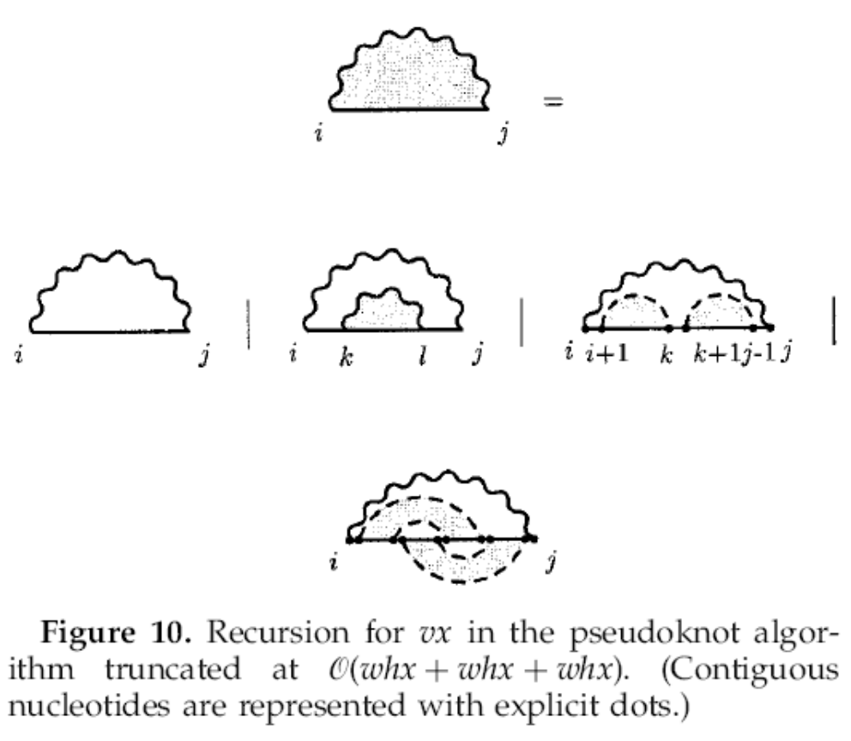
The pseudoknot algorithm

Slide 18
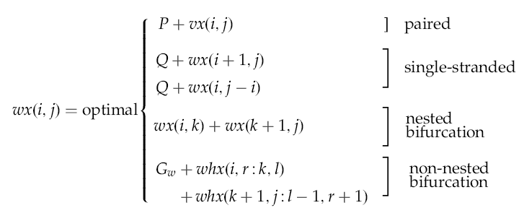
The pseudoknot algorithm

Slide 19
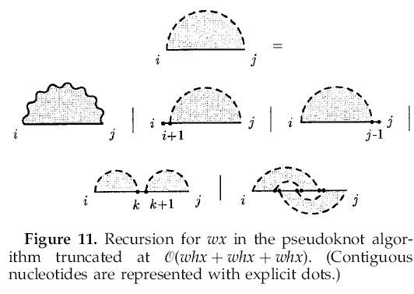
The pseudoknot algorithm

Slide 20
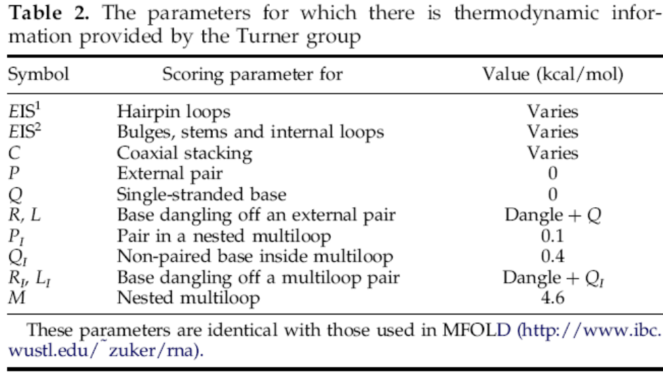
The parameters

